Slide 1
The Pac-Man Projects
P0: UNIX/Python Tutorial
P1: Search
P2: Multi-Agent Search
P3: Reinforcement Learning
P4: BNs and HMMs: Ghostbusters
P5: Machine Learning: Classification

Slide 2
Project 1: Search
http://inst.cs.berkeley.edu/~cs188/sp20/project1/

Slide 3
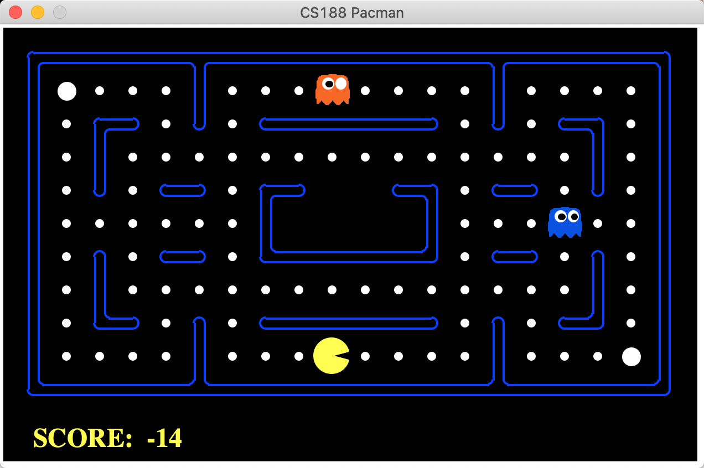

Slide 4
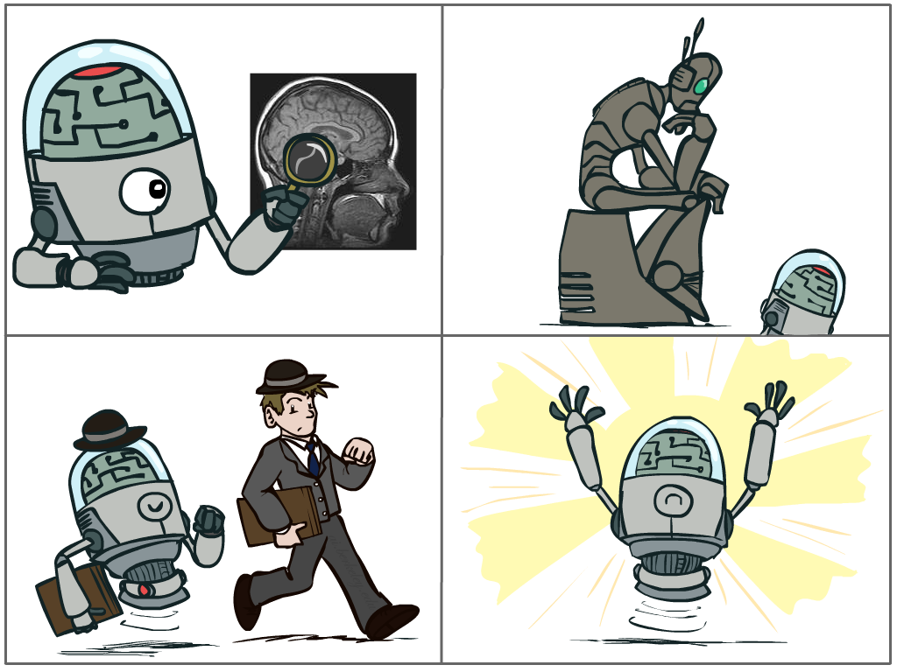
What is AI?
The science of making machines that:
Think like people
Think rationally
Act like people
Act rationally
Notes:
Top left: Think like people --- cognitive science, neuroscience
Bottom left: act like people --- actually very early definition, dating back to Alan Turing --- Turing test; problem to do really well you start focusing on things like don’t answer too quickly what the square root of 1412 is, don’t spell too well, and make sure you have a favorite movie etc. So it wasn’t really leading us to build intelligence
Think rationally – long tradition dating back to Aristotle --- but not a winner, because difficult to encode how to think, and in the end it’s not about how you think, it’s about how you end up acting

Slide 5
Rational Decisions（理性决策）
We’ll use the term rational in a very specific, technical way:
Rational: maximally achieving pre-defined goals
Rationality only concerns what decisions are made
(not the thought process behind them)
Goals are expressed in terms of the utility（效用） of outcomes
Being rational means maximizing your expected utility
A better title for the course CS188 would be:
Computational Rationality（计算合理性）
Notes:
Example of utilities. 10 for A, 1 for each Friday with friends

Slide 6
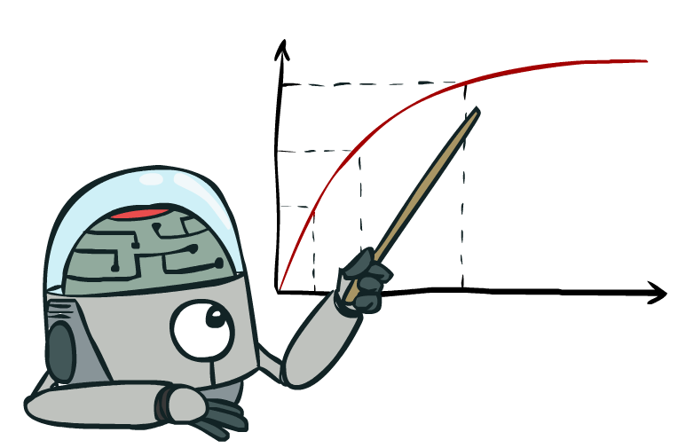
Maximize Your
Expected Utility
Notes:
Distill course to maximize expected utility.
Make these 4 better

Slide 7
What Can AI Do?

Slide 8
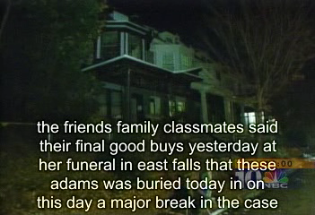
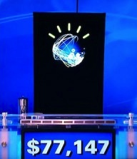


Natural Language
Speech technologies (e.g. Siri)
Automatic speech recognition (ASR)
Text-to-speech synthesis (TTS)
Dialog systems
Language processing technologies
Question answering
Machine translation
Web search
Text classification, spam filtering, etc…
https://play.aidungeon.io/
Notes:
Deepfake
chatbot examples
Do you know about IBM watson, Ken Jennings. Impressive because...
Expensive wayto win $70k
Figure out what she said, pertty good, hard to get intent
engaged in day to day basis
My favorite application is AI dungeon – you write commands to your fictional character and it becomes sort of like a book.
I can’t wait for something like this to work with images or clips (where technology is not far behind)

Slide 9
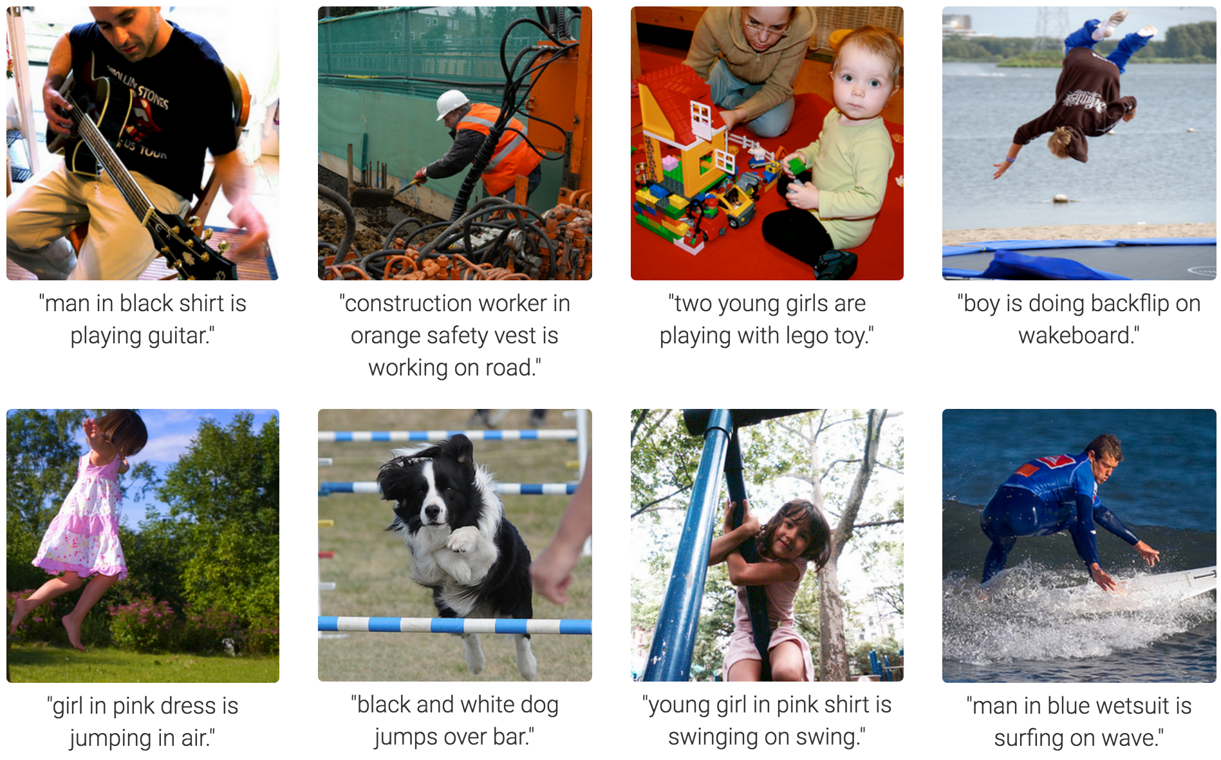
Computer Vision
Karpathy & Fei-Fei, 2015; Donahue et al., 2015; Xu et al, 2015; many more
Notes:
Very Impressive:
Form of prediction and deicion.

Slide 10
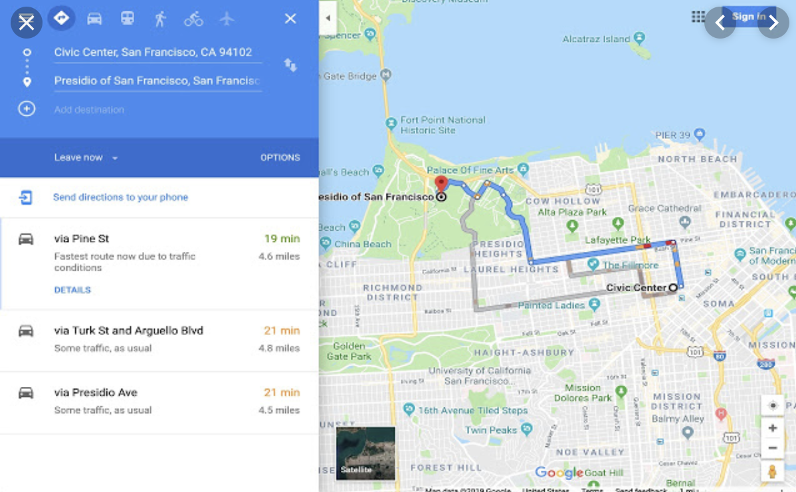
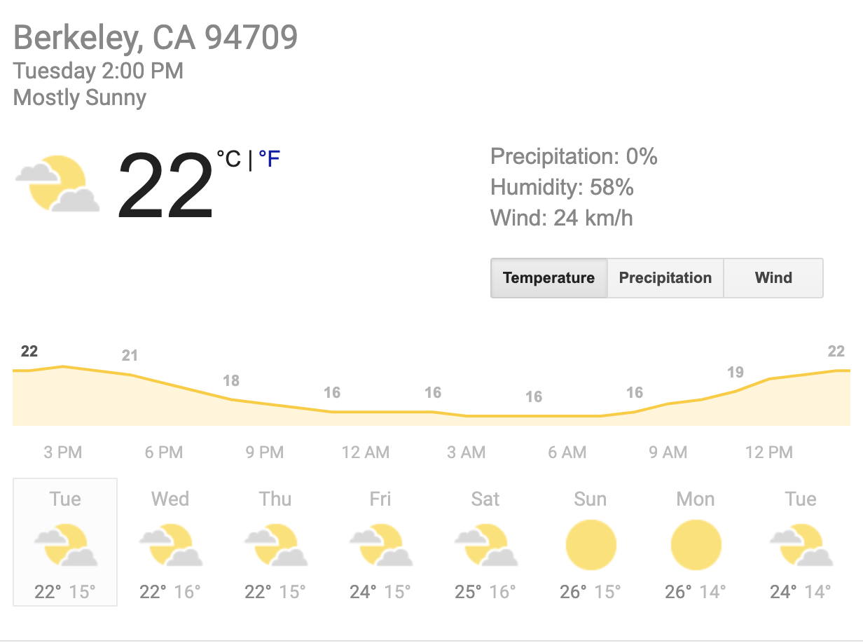


Tools for Predictions & Decisions
Notes:
Many more tools for prediction: Google maps, netflix (amazing recommendation engine)

Slide 11
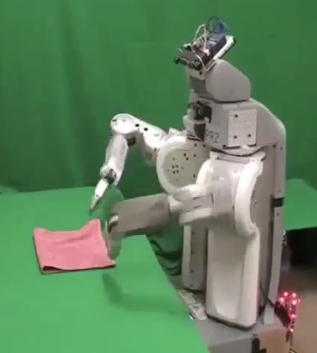
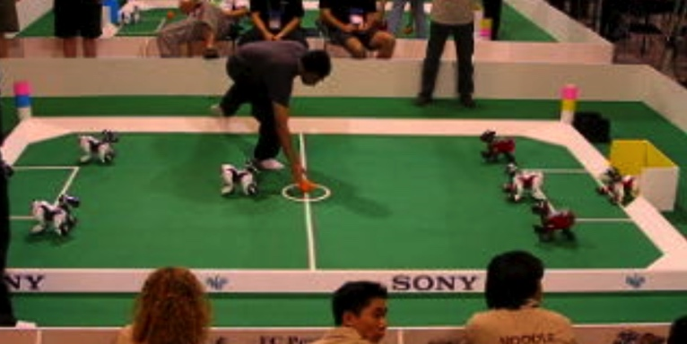
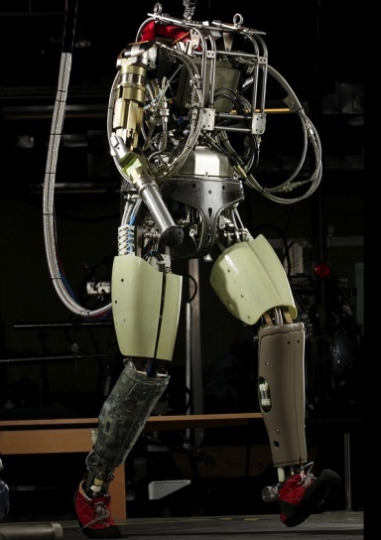
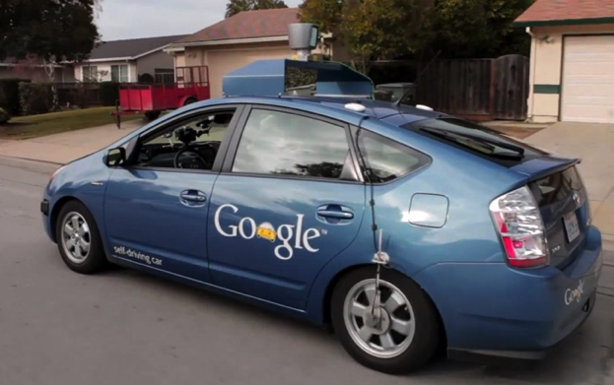
Robotics
Demo 1: ROBOTICS – soccer.avi
Demo 4: ROBOTICS – laundry.avi
Demo 2: ROBOTICS – soccer2.avi
Demo 5: ROBOTICS – petman.avi
Demo 3: ROBOTICS – gcar.avi
Robotics
Part mech. eng.
Part AI
Reality much
harder than
simulations!
Technologies
Vehicles
Rescue
Help in the home
Lots of automation…
In this class:
We ignore mechanical aspects
Methods for planning
Methods for control
Images from UC Berkeley, Boston Dynamics, RoboCup, Google

Slide 12
AI is starting to be everywhere…

Slide 13
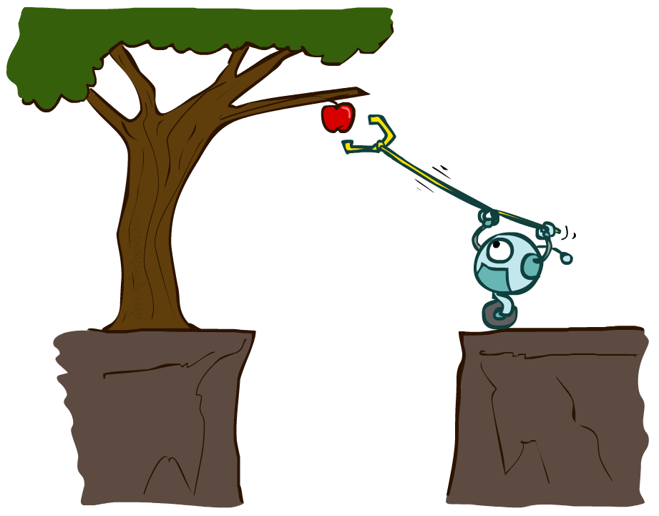
Designing Rational Agents
An agent is an entity that perceives（认知） and acts（行动）.
A rational agent selects actions that maximize its (expected) utility.
Characteristics of the percepts（知觉）, environment（环境）, and action space（动作空间） dictate techniques for selecting rational actions
This course is about:
General AI techniques for a variety of problem types
Learning to recognize when and how a new problem can be solved with an existing technique
Sensors
Agent
Percepts
Environment
?
Actuators
Actions

Slide 14
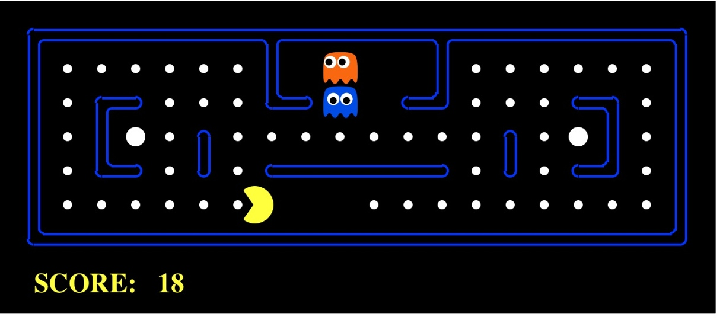
Pac-Man as an Agent
Agent
Environment
Sensors
Percepts
?
Actuators
Actions
Pac-Man is a registered trademark of Namco-Bandai Games, used here for educational purposes
Demo1: pacman-l1.mp4 or L1D2
Notes:
L1D2 =
python demos.py
Select Lecture 1 → select demo 2

Slide 15
Welcome to Pacman
http://inst.cs.berkeley.edu/~cs188/sp20/project1/#welcome-to-pacman

Slide 16
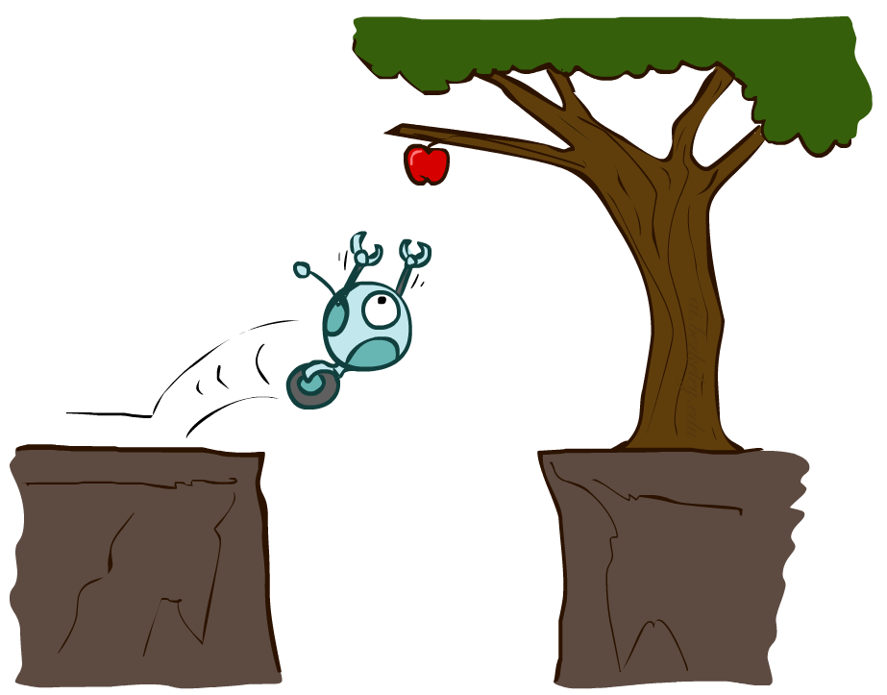
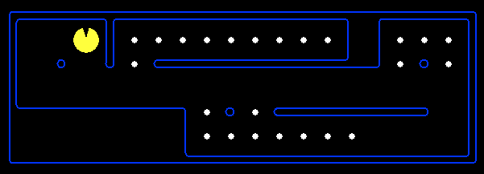
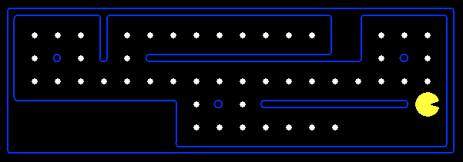
Reflex Agents
Reflex agents:
Choose action based on current percept (and maybe memory)
May have memory or a model of the world’s current state
Do not consider the future consequences of their actions
Consider how the world IS
Can a reflex agent be rational?
[Demo: reflex optimal (L2D1)]
[Demo: reflex optimal (L2D2)]
Notes:
Examples: blinking your eye (not using your entire thinking capabilities), vacuum cleaner moving towards nearest dirt

Slide 17
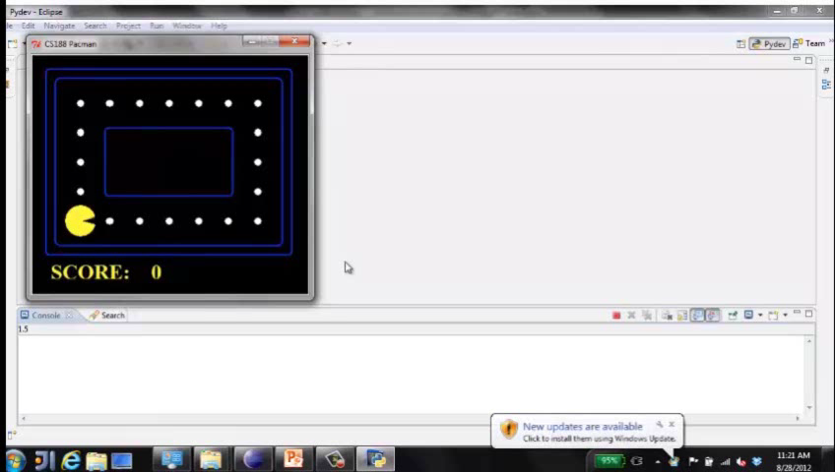
Video of Demo Reflex Optimal

Slide 18
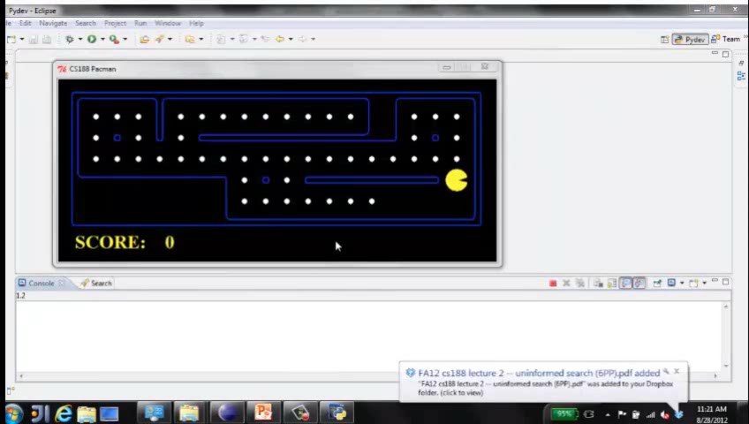
Video of Demo Reflex Odd

Slide 19
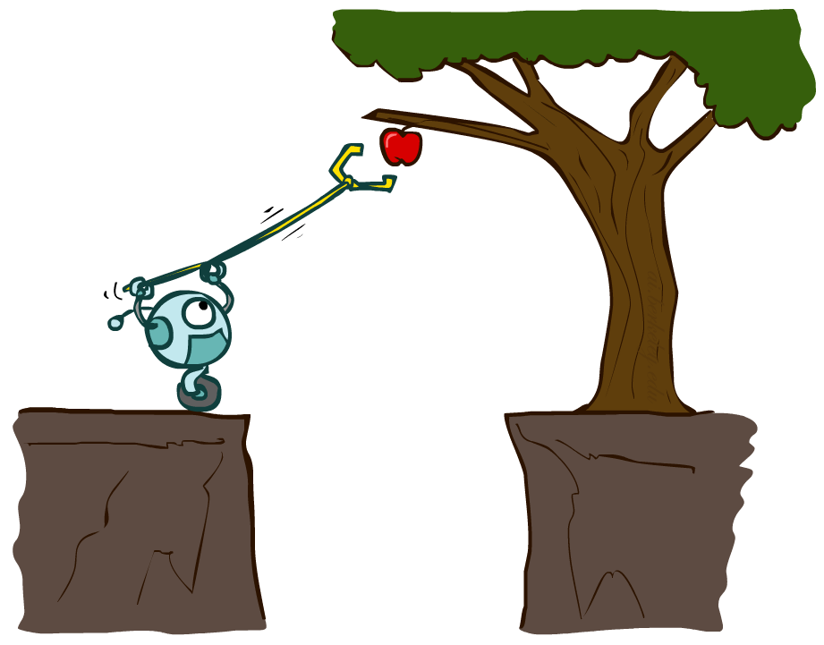
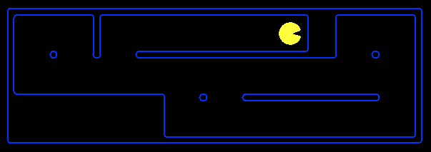
Planning Agents
Planning agents:
Ask “what if”
Decisions based on (hypothesized) consequences of actions
Must have a model of how the world evolves in response to actions
Must formulate a goal (test)
Consider how the world WOULD BE
Optimal（最佳，代价最小） vs. complete（可行，能找到存在的解） planning
Planning（整体规划） vs. replanning（局部最优规划）
[Demo: re-planning (L2D3)]
[Demo: mastermind (L2D4)]

Slide 20
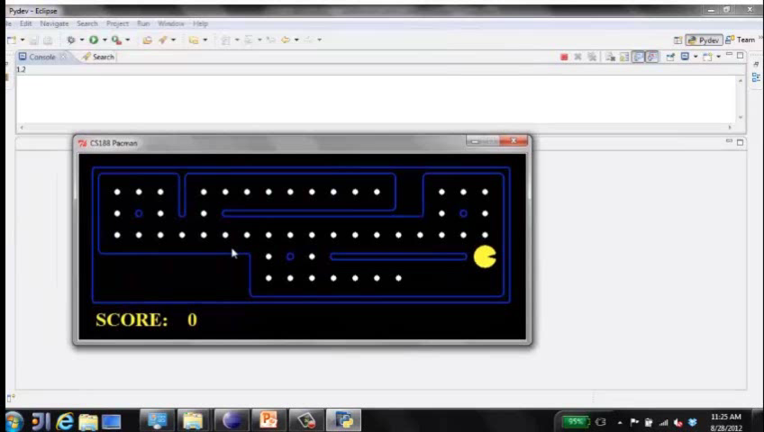
Video of Demo Mastermind

Slide 21
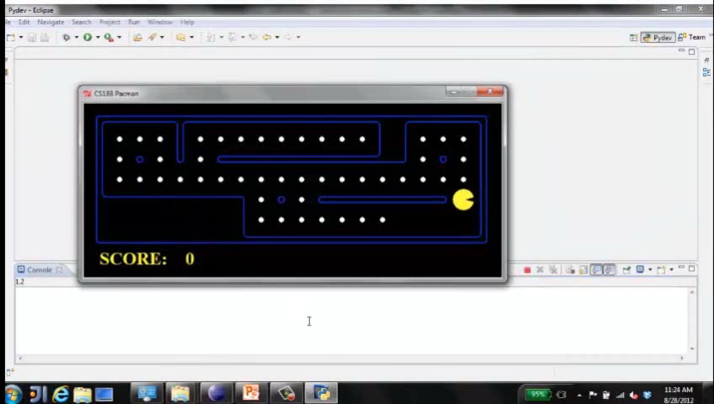
Video of Demo Replanning

Slide 22

Search Problems

Slide 23

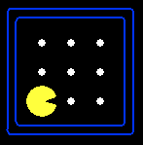





Search Problems
A search problem consists of:
A state space
A successor function
(with actions, costs)
A start state and a goal test
A solution is a sequence of actions (a plan) which transforms the start state to a goal state
“N”, 1.0
“E”, 1.0
Notes:
Often comes back on exams
Goal test – sometimes more than one state that satisfies having achieved the goal, for example, “eat all the dots”
Abstraction

Slide 24
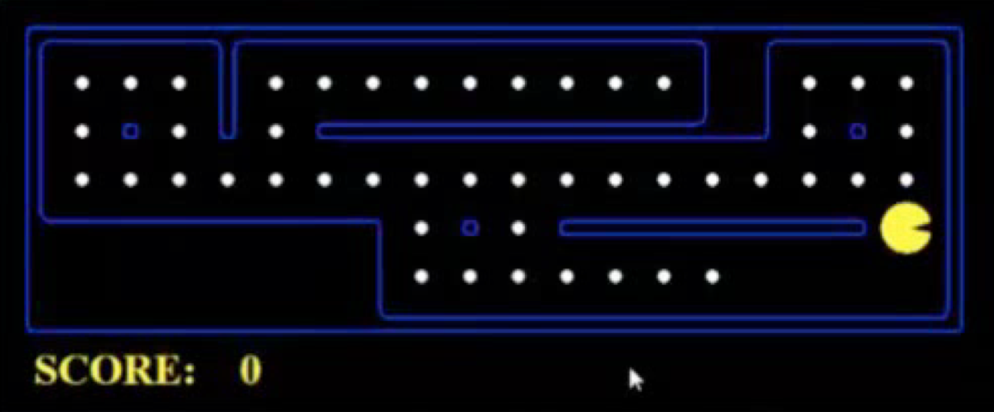
What’s in a State Space?
The world state includes every last detail of the environment
A search state keeps only the details needed for planning (abstraction)
Problem: Pathing
States: (x,y) location
Actions: NSEW
Successor: update location only
Goal test: is (x,y)=END
Problem: Eat-All-Dots
States: {(x,y), dot booleans}
Actions: NSEW
Successor: update location and possibly a dot boolean
Goal test: dots all false
Notes:
Wrong example for “eat-all-dots”: (x, y, dot count)

Slide 25
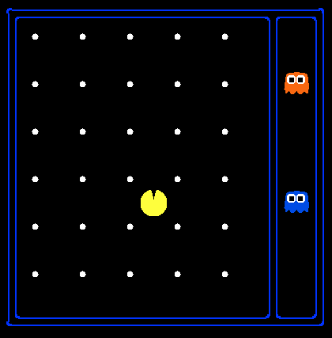
State Space Sizes?
World state:
Agent positions: 120
Food count: 30
Ghost positions: 12
Agent facing: NSEW
How many
World states?
120x(2³⁰)x(12²)x4
States for pathing?
120
States for eat-all-dots?
120x(2³⁰)
Notes:
90 * (2^30-1) + 30 * 2^29 = 145 billion
2^29 = 536 870 912

Slide 26
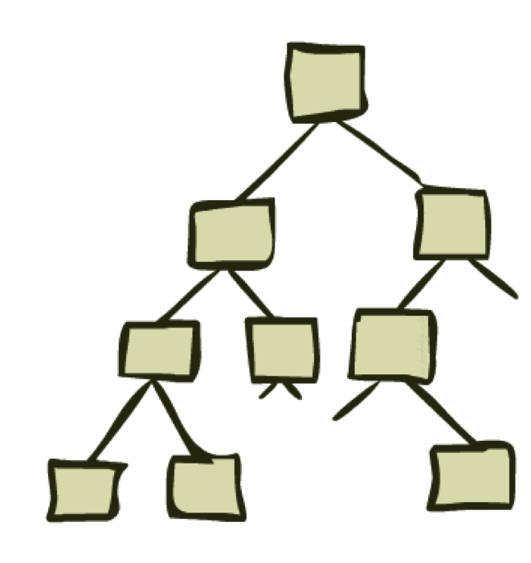
State Space Graphs and Search Trees

Slide 27
State Space Graphs
State space graph: A mathematical representation of a search problem
Nodes are (abstracted) world configurations
Arcs represent successors (action results)
The goal test is a set of goal nodes (maybe only one)
In a state space graph, each state occurs only once!
We can rarely build this full graph in memory (it’s too big), but it’s a useful idea

Slide 28
State Space Graphs
State space graph: A mathematical representation of a search problem
Nodes are (abstracted) world configurations
Arcs represent successors (action results)
The goal test is a set of goal nodes (maybe only one)
In a state space graph, each state occurs only once!
We can rarely build this full graph in memory (it’s too big), but it’s a useful idea
a
G
b
c
e
d
f
S
h
p
q
r
Tiny state space graph for a tiny search problem

Slide 29
Search Trees
This is now / start
“N”, 1.0
“E”, 1.0
Possible futures
A search tree:
A “what if” tree of plans and their outcomes
The start state is the root node
Children correspond to successors
Nodes show states, but correspond to PLANS that achieve those states
For most problems, we can never actually build the whole tree
Notes:
Different plans that achieve the same state, will be different nodes in the tree.

Slide 30
State Space Graphs vs. Search Trees
State Space Graph
Each NODE in the search tree is an entire PATH in the state space graph.
Search Tree
S
a
G
d
e
p
b
c
q
b
c
e
h
r
d
e
f
a
a
h
r
p
q
f
S
h
We construct both on demand – and we construct as little as possible.
p
q
f
q
c
G
p
q
r
q
c
G
a
a

Slide 31

State Space Graphs vs. Search Trees
Consider this 4-state graph:
How big is its search tree (from S)?
a
s
a
b
S
G
b
G
a
G
b
a
G
b
G
…
…
Important: Lots of repeated structure in the search tree!

Slide 32
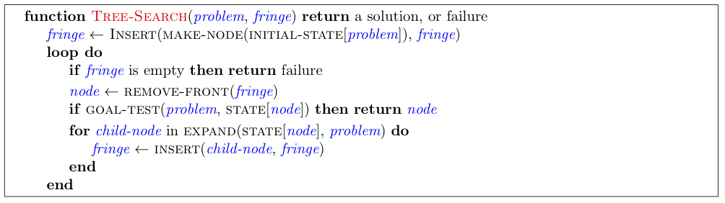
General Tree Search
Important ideas:
Fringe（边缘，目前正要去探索的节点）
Expansion（拓展，通过探索边缘，陆续加入到探索集中的节点）
Exploration strategy（搜索策略）
Main question: which fringe nodes to explore?

Slide 33
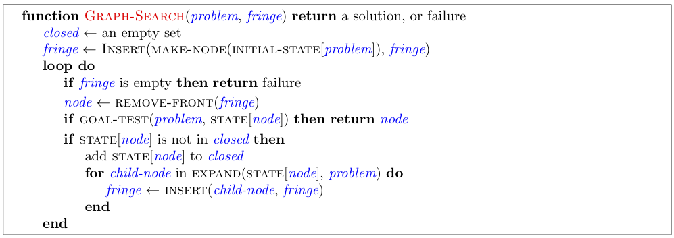
Graph Search Pseudo-Code

Slide 34
Graph Search
In BFS, for example, we shouldn’t bother expanding the circled nodes (why?)
S
d
e
p
b
c
e
h
r
q
a
a
h
r
p
q
f
p
q
f
q
c
G
q
c
G
a
a

Slide 35

Depth-First Search（深度优先搜索）

Slide 36
Depth-First Search
Strategy: expand a deepest node first
Implementation: Fringe is a LIFO stack
LIFO: Last-In First-Out
a
G
a
c
b
c
b
e
d
e
d
f
f
S
h
h
p
p
r
q
r
q
S
d
e
p
b
c
e
h
r
q
a
a
h
r
p
q
f
p
q
f
q
c
G
q
c
G
a
a

Slide 37
Question 1 (3 points): Finding a Fixed Food Dot using Depth First Search
http://inst.cs.berkeley.edu/~cs188/sp20/project1/#question-1-3-points-finding-a-fixed-food-dot-using-depth-first-search

Slide 38
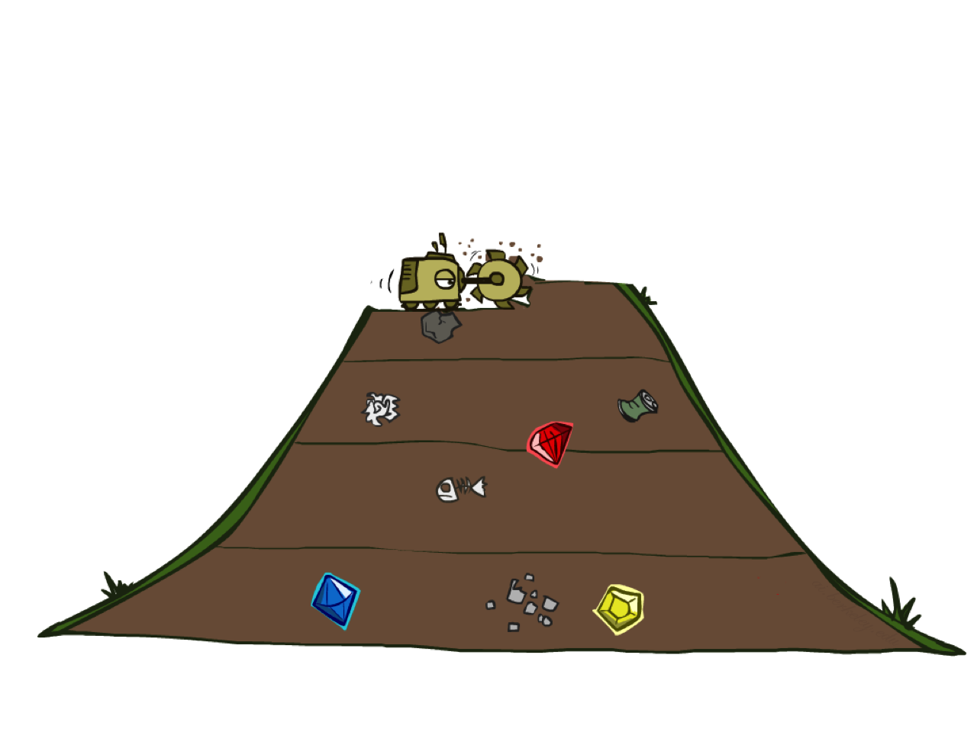
Breadth-First Search

Slide 39
Breadth-First Search
Strategy: expand a shallowest node first
Implementation: Fringe is a FIFO queue
FIFO: First-In First-Out
a
G
b
c
d
e
f
S
h
p
q
r
S
d
e
p
Search
Tiers
b
c
e
h
r
q
a
a
h
r
p
q
f
p
q
f
q
c
G
q
c
G
a
a

Slide 40
Question 2 (3 points): Breadth First Search
http://inst.cs.berkeley.edu/~cs188/sp20/project1/#question-2-3-points-breadth-first-search

Slide 41
Quiz: DFS vs BFS
When will BFS outperform DFS?
When will DFS outperform BFS?
[Demo: dfs/bfs maze water (L2D6)]

Slide 42

Video of Demo Maze Water DFS/BFS (part 1)

Slide 43
Video of Demo Maze Water DFS/BFS (part 2)

Slide 44
Cost-Sensitive Search
a
GOAL
2
2
b
c
3
2
1
8
2
e
d
f
3
9
8
2
START
h
1
4
2
p
4
r
15
q
BFS finds the shortest path in terms of number of actions.
It does not find the least-cost path. We will now cover
a similar algorithm which does find the least-cost path.

Slide 45

Uniform Cost Search

Slide 46
Uniform Cost Search
2
G
a
Strategy: expand a cheapest node first:
Fringe is a priority queue (priority: cumulative cost)
b
c
1
8
2
2
e
3
d
f
9
8
2
S
h
1
1
p
q
r
15
0
S
d
3
e
9
p
1
b
4
e
5
h
17
r
11
q
16
c
11
Cost contours
a
6
a
h
13
r
7
p
q
f
p
q
f
8
q
c
G
q
c
a
11
G
10
a

Slide 47
Question 3 (3 points): Varying the Cost Function
http://inst.cs.berkeley.edu/~cs188/sp20/project1/#question-3-3-points-varying-the-cost-function

Slide 48
Video of Demo Maze with Deep/Shallow Water --- DFS, BFS, or UCS? (part 3)
Notes:
Let students guess which one of the three it is. (This is DFS.)

Slide 49
Video of Demo Maze with Deep/Shallow Water --- DFS, BFS, or UCS? (part 1)
Notes:
Let students guess which one of the three it is. (This is BFS.)

Slide 50
Video of Demo Maze with Deep/Shallow Water --- DFS, BFS, or UCS? (part 2)
Notes:
Let students guess which one of the three it is. (This is UCS.)

Slide 51
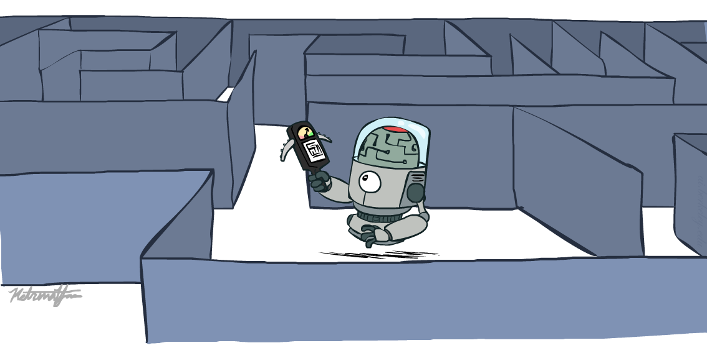
CS 188: Artificial Intelligence
Informed Search
Instructors: Pieter Abbeel & Dan Klein
University of California, Berkeley
Notes:
Please retain proper attribution, including the reference to ai.berkeley.edu. Thanks!

Slide 52
Video of Demo Contours UCS Pacman Small Maze

Slide 53



Search Heuristics（启发式搜索）
A heuristic is:
A function that estimates how close a state is to a goal
Designed for a particular search problem
Examples: Manhattan distance, Euclidean distance for pathing
10
5
11.2

Slide 54

Greedy Search

Slide 55
Greedy Search
b
Strategy: expand a node that you think is closest to a goal state
Heuristic: estimate of distance to nearest goal for each state
A common case:
Best-first takes you straight to the (wrong) goal
Worst-case: like a badly-guided DFS
…
b
…
[Demo: contours greedy empty (L3D1)]
[Demo: contours greedy pacman small maze (L3D4)]
Notes:
For any search problem, you know the goal. Now, you have an idea of how far away you are from the goal.

Slide 56
Video of Demo Contours Greedy (Empty)

Slide 57
Video of Demo Contours Greedy (Pacman Small Maze)

Slide 58
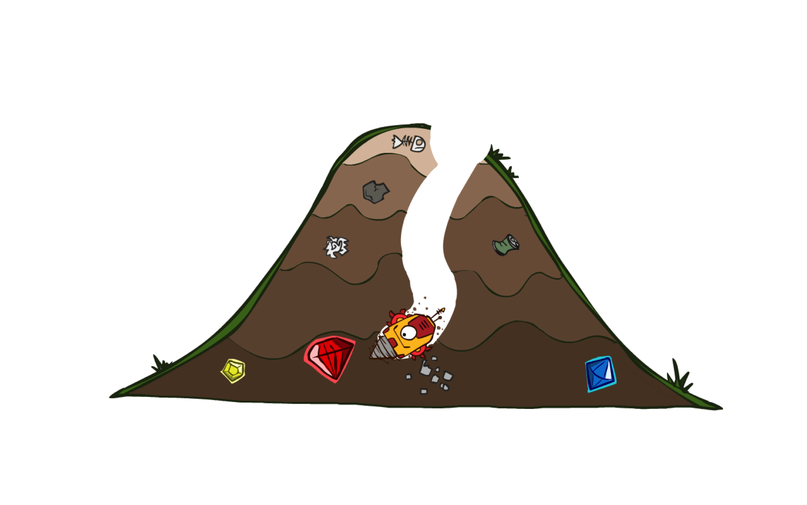
A* Search

Slide 59
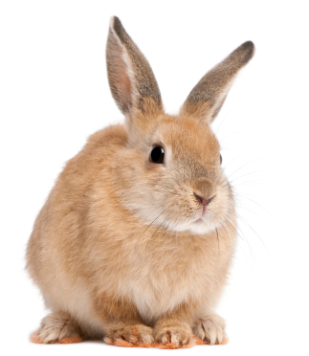
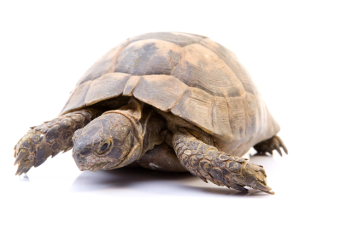
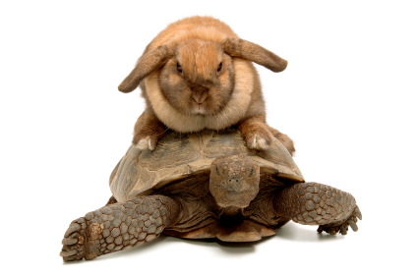
A* Search
UCS
Greedy
A*
Notes:
Notes: these images licensed from iStockphoto for UC Berkeley use.

Slide 60
Combining UCS and Greedy
Uniform-cost orders by path cost, or backward cost g(n)
Greedy orders by goal proximity, or forward cost h(n)
A* Search orders by the sum: f(n) = g(n) + h(n)
8
g = 0 h=6
S
e
h=1
g = 1 h=5
a
1
1
3
2
g = 2 h=6
g = 9 h=1
S
a
d
G
b
d
g = 4 h=2
e
h=6
1
h=5
h=2
h=0
1
g = 3 h=7
g = 6 h=0
g = 10 h=2
c
b
c
G
d
h=7
h=6
g = 12 h=0
G
Example: Teg Grenager

Slide 61
Question 4 (3 points): A* search
http://inst.cs.berkeley.edu/~cs188/sp20/project1/#question-4-3-points-a-search

Slide 62



Comparison
Greedy
Uniform Cost
A*

Slide 63
Question 5 (3 points): Finding All the Corners
http://inst.cs.berkeley.edu/~cs188/sp20/project1/#question-5-3-points-finding-all-the-corners

Slide 64
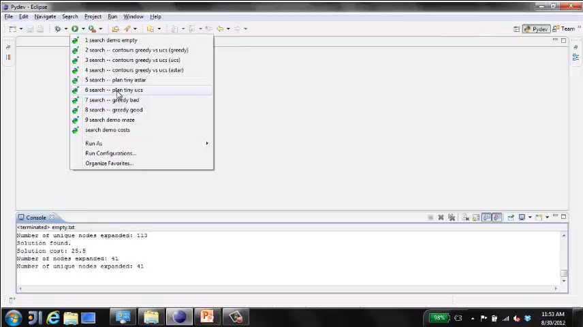
Video of Demo Pacman (Tiny Maze) – UCS / A*

Slide 65
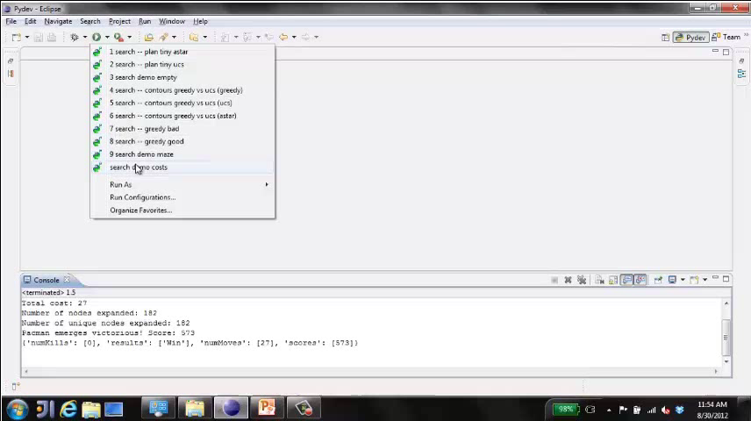
Video of Demo Empty Water Shallow/Deep – Guess Algorithm

Slide 66
Question 6 (3 points): Corners Problem: Heuristic
http://inst.cs.berkeley.edu/~cs188/sp20/project1/#question-6-3-points-corners-problem-heuristic

Slide 67
Question 7 (4 points): Eating All The Dots
http://inst.cs.berkeley.edu/~cs188/sp20/project1/#question-7-4-points-eating-all-the-dots

Slide 68
Question 8 (3 points): Suboptimal Search
http://inst.cs.berkeley.edu/~cs188/sp20/project1/#question-8-3-points-suboptimal-search

Slide 69
Mini-Contest 1: Multi-Agent Pacman
http://inst.cs.berkeley.edu/~cs188/sp20/minicontest1/

